Slide 1
RUNGTA COLLEGE OF DENTAL SCIENCES & RESEARCH
TITLE OF THE TOPIC: MICROBIOLOGY IN ENDODONTICS
DEPARTMENT OF CONSERVATIVE DENTISTRY AND ENDODONTICS

Slide 2
Specific learning Objectives
At the end of this presentation the learner is expected to know
Core areas* H | Domain ** | Category #
Routes of microorganism, Microrganism associated with root canal infection | Cognitive | Must know
Intraradicular infection, extraradicular infection | Psychomotor | Nice to know
Methods of identification of microbes | Affective | Desire to know
*Subtopic of importance
** Cognitive, Psychomotor or Affective
# Must know , Nice to know & Desire to know

Slide 3
TABLE OF CONTENT:
INTRODUCTION
ROUTES OF MICROORGANISM INGRESS
MICROORGANISMS FOUND IN ROOT CANALS ASSOCIATED WITH ENDODONTIC INFECTIONS
INTRARADICULAR INFECTION
EXTRARADICULAR INFECTION
METHODS FOR IDENTIFICATION OF MICROBES

Slide 4
MICROORGANISMS FOUND IN ENDODONTIC INFECTION
Polymicrobial interactions and nutritional requirements make the cultivation and identification of all organisms from endodontic infections very difficult.
Black pigmented bacteria are currently are the subject of extensive basic science research and clinical studies as the main causative agent of endodontic infections, the severity of such infection, and the resultant clinical symptoms associated with these infections.

Slide 5
These anaerobic invaders are not found clinically in pure culture because of their synergistic nature requiring specific nutrients for growth and the presence of other organism to supply some of the products necessary for survival.
Therefore , attention to these newly studied organism should not detract completely from the classical early microbiologic investigations by researchers that searched for cause and effect relationship between specific microbes and endodontic infections

Slide 6
M.orgs of oral cavity, upper respiratory tract, sinus area, nasopharynx or GIT can gain access to the root canal system, thus the genera and species that must be dealt is vast
Invaders of the endodontic complex may not be pathogenic in root canal environment because of change in oxygen and nutrient levels

Slide 7
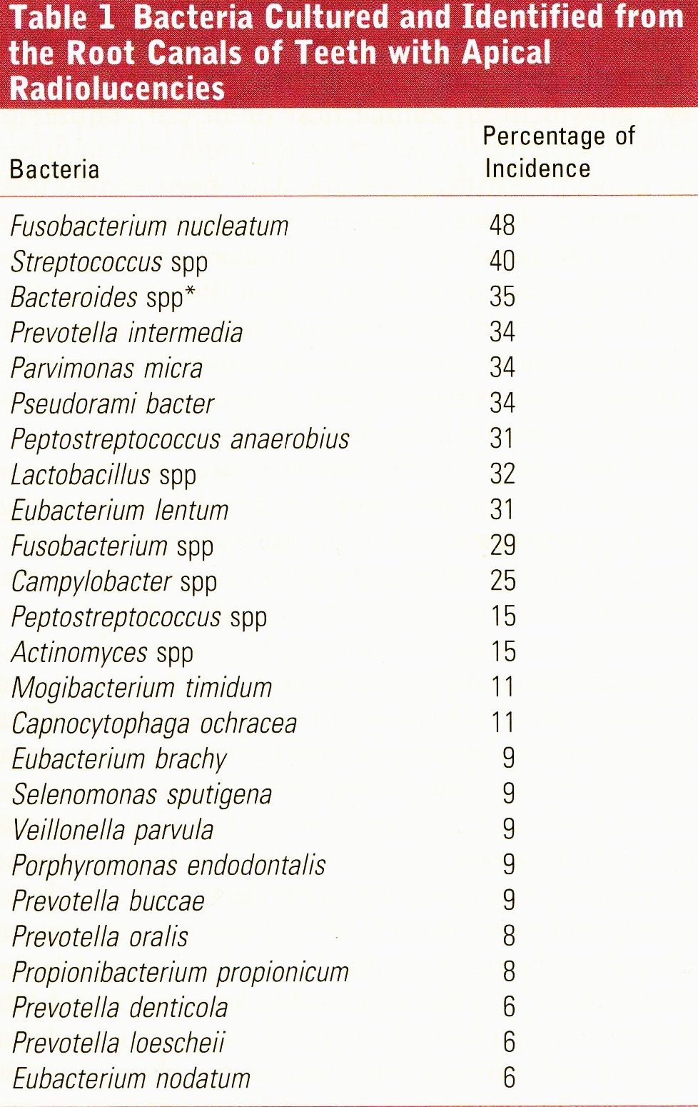
On the other hand, many species that are normal, non pathogenic resident of oral cavity become invasive, destructive, producing toxins and enzymes that causes inflammation, tissue necrosis and infection.

Slide 8
Aerobes
Alpha hemolytic streptococci were the most commonly recovered organisms.
Streptococcus mitis and streptococcus salivarius are numerous in oral cavity, as well in infected root canals
S. mitis is of particular importance as it is frequently cultured from heart valves after attacks of subacute bacterial endocarditis, therefore proving its pathogenecity in a site remote from the root canal

Slide 9
Beta hemolytic and less pathogenic non hemolytic streptococcus were also cultured in large numbers
Recent research varifies that there is still great significance in the presence of streptococcus org because of their cell wall components
Peptidoglycans and lipoteichoic acids give structural rigidity to the cell wall

Slide 10
Osteoclast activating factor and prostaglandins production is a result of peptidoglycan action
Immunologically peptidoglycans activate, complement and stimulate B lymphocytes.
Lipoteochoic acids enhance the destructive process by inducing bone resorption and immunologically by activating the complement system.
Both mediators enhance the pathogenicity and symptoms of infectious disease of the periapical tissue

Slide 11
Enterococci, commonly residents of digestive tract, were also commonly recovered in endodontics cultures.
Some species such as S. faecalis are difficult to eliminate from endodontic infections because of their resistance to many antimicrobial agents

Slide 12
Anaerobes
Prior to 1969, very few strains of strict anaerobes were isolated and identified because of inadequate anaerobic culturing methods
The importance of anaerobic bacteria in pulpal and periapical pathoses has been revealed with the developing anaerobic culturing methods and use of both selective and non selective culture media
Notes:
Obligate anaerobes: do not required o2 for growth. Grow only in absence of o2. present as normal flora and contribute to endogenous infections in oral cavity.
Facultative : use O2 to enhance their growth. Can also grow in absence of O2.
Pathogenicity: ability of a microorganism to produce disease. Virulence: degree of pathogenicity

Slide 13
However, even with the most sophisticated culture methods, there are still many m.orgs that remain uncultivable
Most of the bacteria in an endodontic infection are strict anearobes.
These bacteria grow only in the absence of oxygen but vary in their sensitivity to oxygen

Slide 14
Facultative anaerobes grow in the presence or absence of oxygen and usually have the enzymes superoxide dismutase and catalase.
The dynamics of bacteria in infected root canals have been studied in monkeys.
Initially facultative bacteria predominated , however with increasing time, the facultative bacteria were displaced by anaerobic bacteria.

Slide 15
The root canal system is a selective habitat that allows the growth of certain species of bacteria in preferance to others
Tissue fluid and the breakdown products of necrotic pulp provide nutrients rich with polypeptides and aminoacids.
These nutrients, low oxygen tension, and bacterial byproducts determine which bacteria will predominate.

Slide 16
Antagonist relationships between bacteria may occur.
Some metabolites (eg.., ammonia) may be either a nutrient or a toxin, depending on the concentration
In addition bacteria may produce bacteriocins, which are antibiotic like proteins, in order to inhibit another species of bacteria.

Slide 17
In 1976, sundquist et al cultured intact root canals of 32 cases.
Of the 32 cases, 18 positive cultures were incubated
All 18 teeth had periradicular destruction
7 teeth exhibited painfull symptoms & 11 were asymptomatic

Slide 18
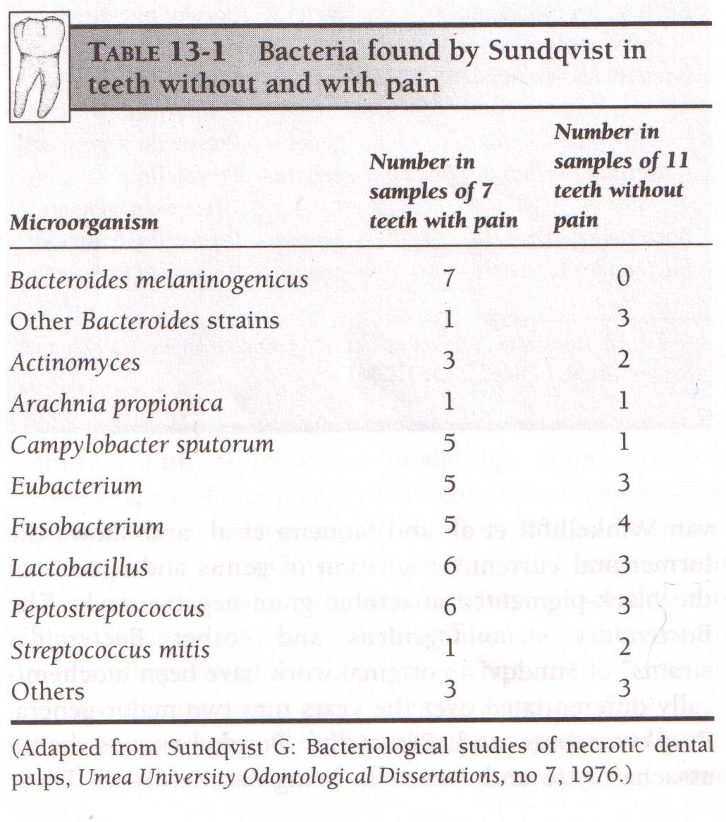
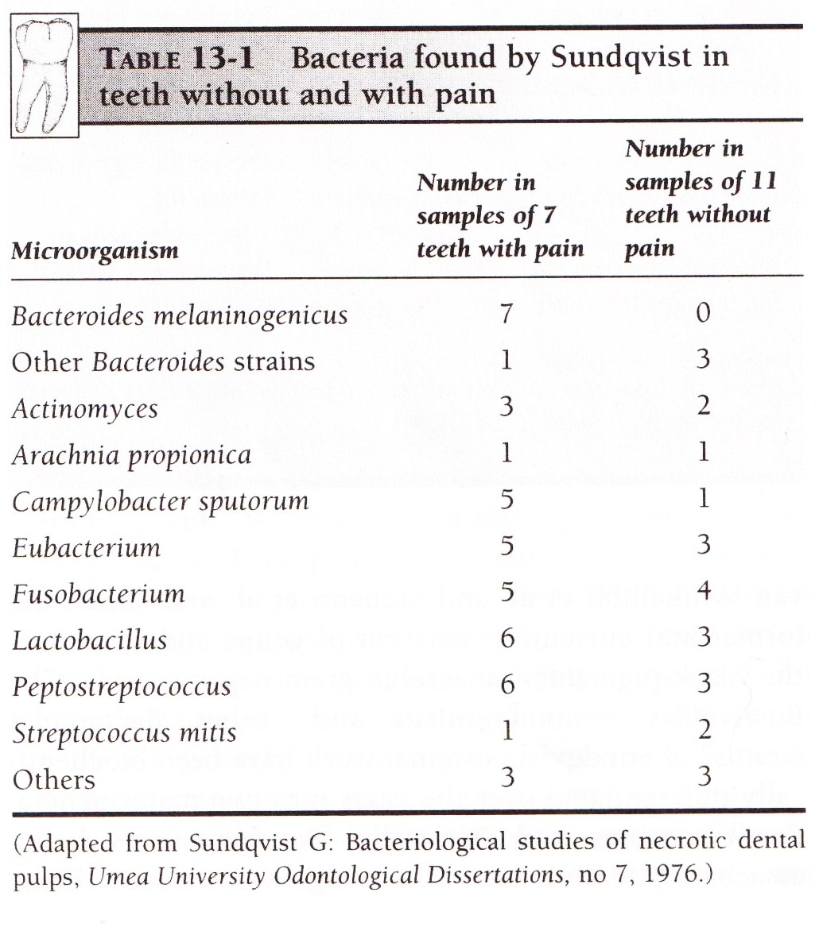

Slide 19
The striking discovery was that black pigmented anaerobic rods were only present in all 7 symptomatic cases and could not be detected in all 11 teeth without pain
Although criticized, the pioneering effort inspired many researchers
Baumgartner et al in 1992, cultured the apical 5mm of root canal exposed by caries and found 67% of microbes were strict anaerobes

Slide 20
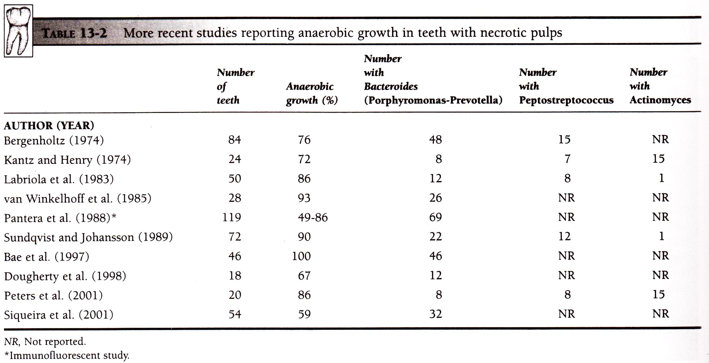

Slide 21
Although no absolute correlation has been made between any species of bacteria and severity of endodontic infection.
However several species have been implicated with some clinical sign and symptoms
Those species include dark pigmented bacteria, Peptostreptococcus, Eubacterium, Fusobacterium and Actinomycosis

Slide 22
Dark pigmented bacteria have been associated with clinical signs and symptoms in several studies.
Earlier researches were based on conventional identification of microbes which was based on gram stain, colonial morphology, growth characteristic and biochemical tests.

Slide 23
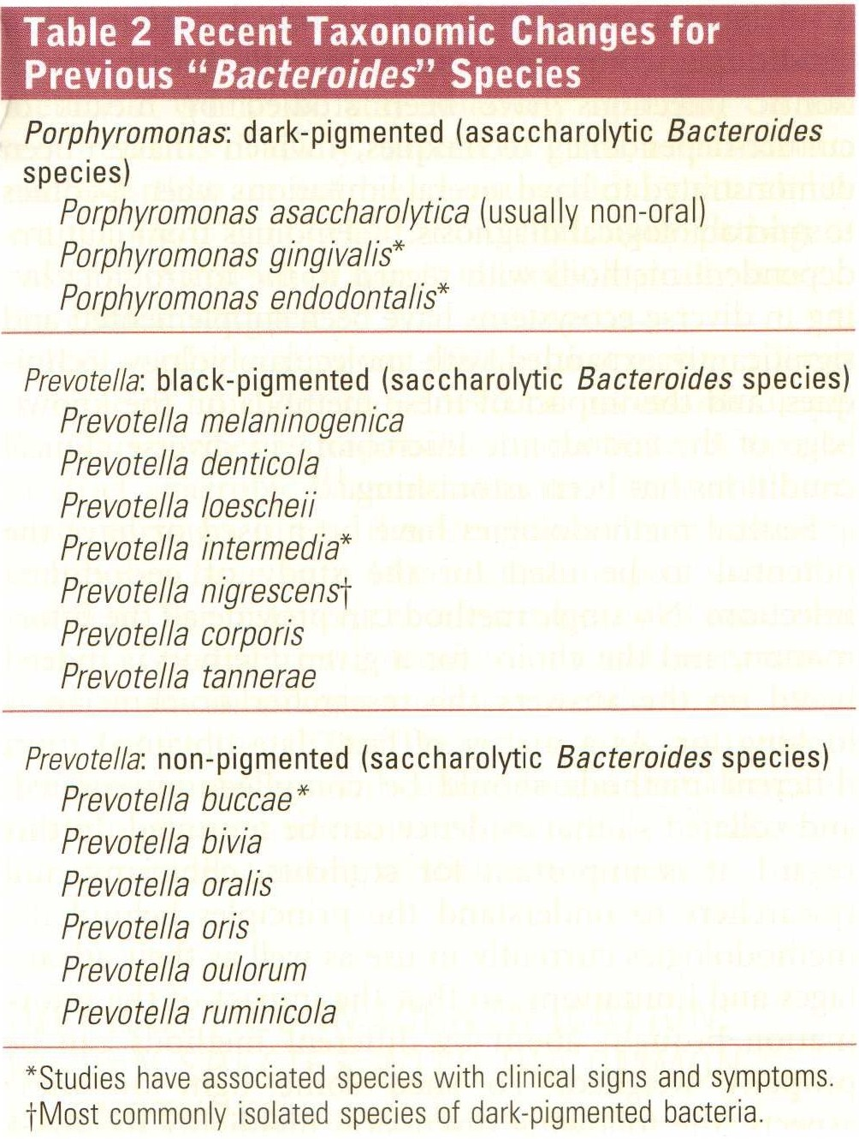
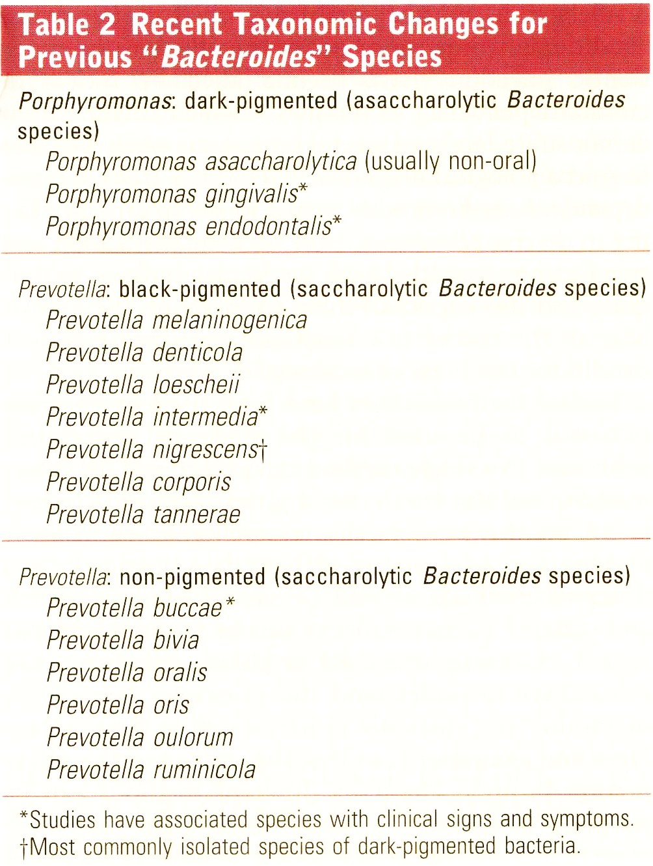

Slide 24
Dark pigmented bacteria ranges from being tan to black colonies depending on the media and environment of incubation in the laboratory
Previously , prevotella intermedia was the species of dark pigmented bacteria most commonly isolated from endodontic infection.
In 1992, isolated previously thought to be P. intermedia were shown to be closely related species known as P. nigrescens

Slide 25
Studies have shown that P. nigrescens is actually dark pigmented bacteria most commonly identified after isolation from both root canal as well as periapical abscess
Another study associating dark pigmented bacteria with endodontic infection found them is 55% of 40 intact teeth having necrotic pulp & apical periodontitis
16 of 22 teeth were associated with purulent drainage or associated sinus tract

Slide 26
Strains of dark pigmented bacteria previously identified using conventional technique were determined to be P. tannarae.
Bystorm et al cultured 140 teeth with nectrotic tissue in root canals and bone destruction in periapical area, and found 80% presence of anaerobic strains with Porphyromonas and Peptostreptococcus

Slide 27
In 1980, Griffee et al found symptoms such as pain, foul odor, sinus tract, sensitivity to percussion and localized swelling statistically greater in cases where Porphyromonas and Prevotella were present.
Further studies by other researchers have shown a definite relationship between the spread of symptomatic endodontic infection and enzyme production by anaerobes such as Eubacterium, Prevotella, Peptococcus and Porphyromonas.

Slide 28
Yamasaki et al., Horiba et al and others have shown the presence of lipopolysaccharide in cases with necrotic pulp and periapical infections.
Henderson and Wilson, as well as Matsushita et al, stated that lipopolysaccharide and peptidoglycans induce cytokines which are essential to destructive process of localizaed infections

Slide 29
They have also demonstrated that this endotoxins enhances virulence by production of collagenase, interlukins.
They also induce production of pain mediators like bradykinin, histamine etc

Slide 30
Several studies of endodontically treated teeth requiring retreatment have shown a prevalence of facultative bacteria, esp enterococcus faecalis, instead of strict anaerobes
Studies using molecular methods have detected numerous other species in root canals that have failed to heal
In addition, fungi have been shown to be associated with failed root canals

Slide 31
Teaching Materials
Endodontic practices - Grossman
Pathways of pulp – Cohen
Textbook of Endodontics – Nisha Garg
Endodontics - Ingle

Slide 32
TAKE HOME MESSEGE/ FOR THE TOPIC COVERED (SUMMARY)
Infection of the root canal is not a random event.
The type and mix of the microbial flora develop in response to the surrounding environment. Microorganisms that establish in the untreated root canal experience an environment of nutritional diversity.
In contrast, well-filled root canal offers the microbial flora a small, dry, nutritionally limited space.
Thus, we should obtain a better understanding of the characteristics and properties of bacteria and their biofilms along with the environmental changes, to enhance success.

Slide 33
Question & Answer Session
List microrganisms found in endodontic infection

Slide 34
REFERENCES
Endodontic practices - Grossman
Pathways of pulp – Cohen
Textbook of Endodontics – Nisha Garg
Endodontics - Ingle

Slide 35
THANK YOU

